Slide 1
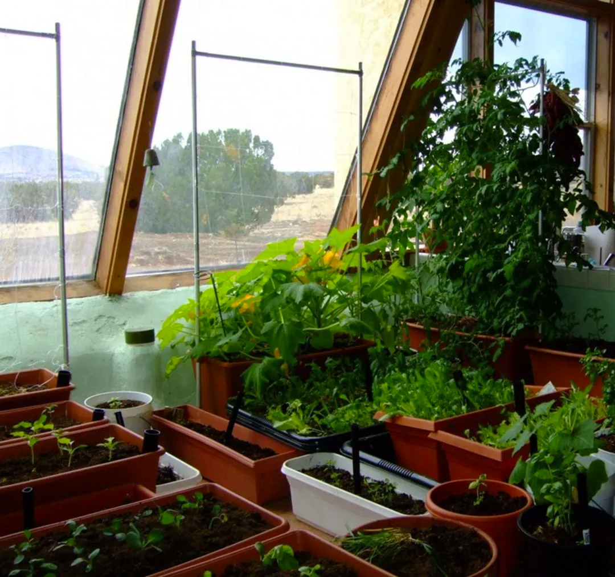
Automatic Houseplant Irrigation System

Slide 2
Why automatically water plants?
Your plants won’t suffer from your forgetfulness
Save on your water bill
Log water uptake by plant
Go on vacation without worrying about your garden

Slide 3
Methodology
● Continuously monitor the amount of soil water available to the plant based on the soil type.
● Determine if watering is required for the plants.
● Monitor the water level of the water storage. [not simulated]
● Supply the exact amount of water required for the crops.
● Turn off the water pump when the required amount has been delivered to the plants.

Slide 4
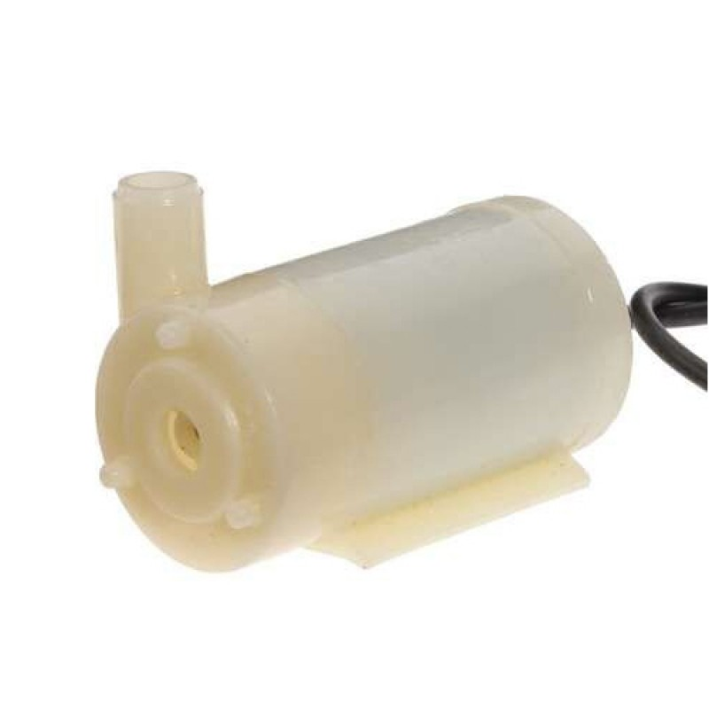
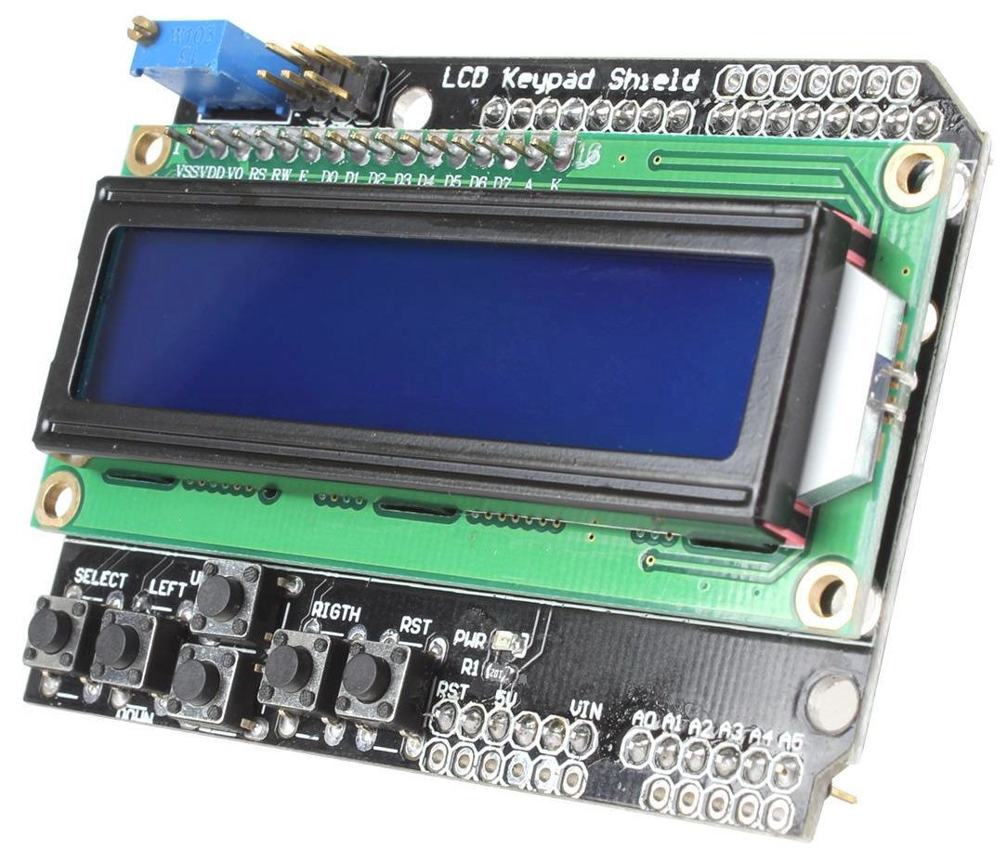
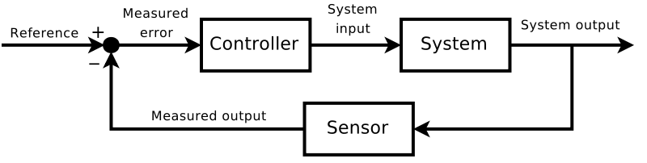
Key features
Four separately controlled pumps
LCD display and keypad I/O
Automatic irrigation control via closed-loop feedback control
Adjustable controls per plant
Data logging to EEPROM (hourly resolution)

Slide 5
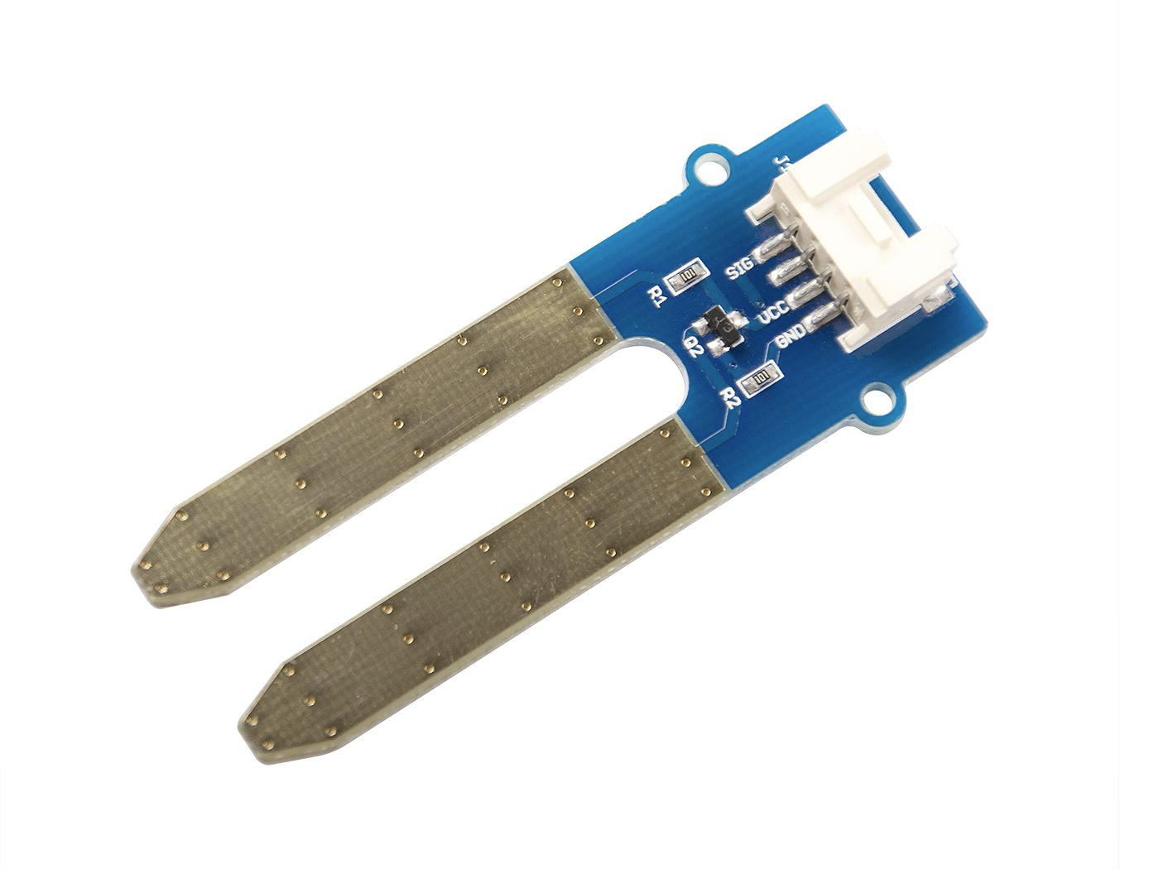
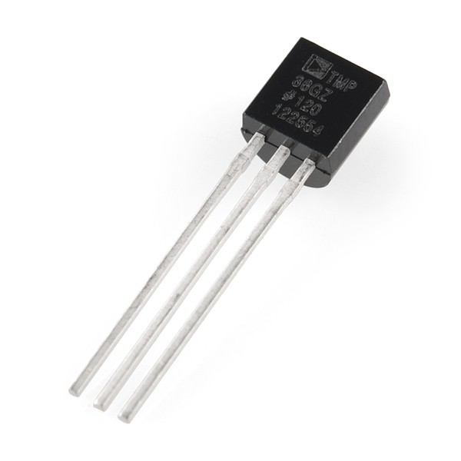
Bill of materials
Microcontroller:
Arduino Uno SMD R3
Sensors:
Soil moisture: Grove Moisture Sensor v1.4 (resistive)
Temperature: TMP36 (DIP)
Actuators:
Pump: DC 12V Submersible Pump
Power control:
NPN transistors
SPST relays
DC-DC buck-boost converter (not simulated)
Input/Output:
LCD 2x16 display
Button keys

Slide 6
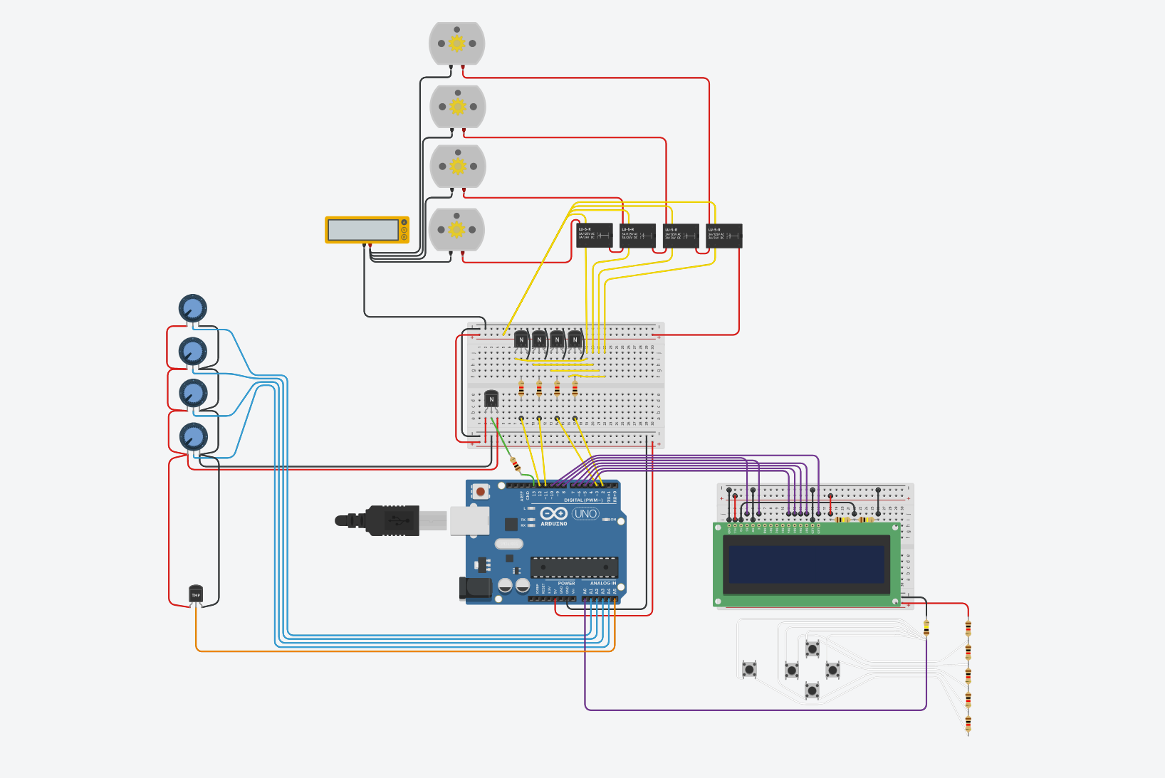
Circuit Diagram
Pumps
Relays & transistors
Sensors
Display & I/O

Slide 7
Circuit Diagram
Pumps
Relays & transistors
Sensors
Display & I/O

Slide 8
Circuit Diagram
Pumps
Relays & transistors
Sensors
Display & I/O

Slide 9
Circuit Diagram
Pumps
Relays & transistors
Sensors
Display & I/O

Slide 10
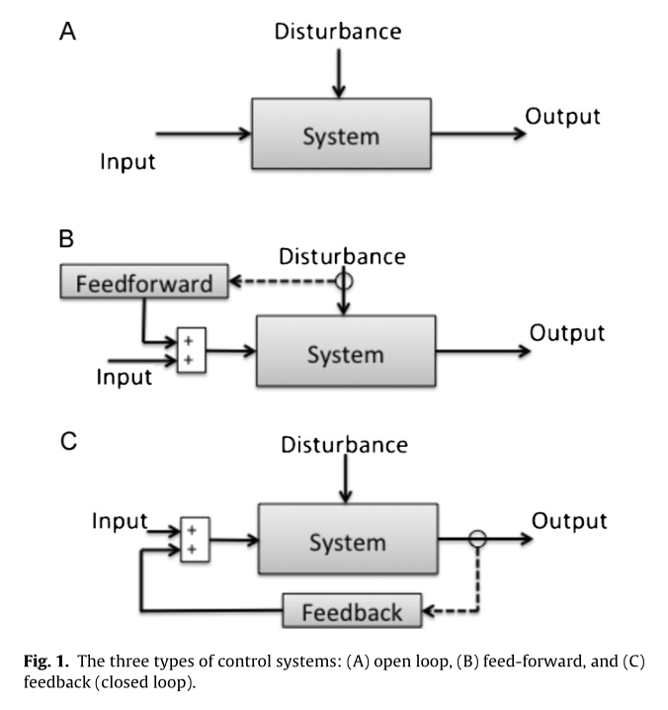
Control logic
On-off pump control
“Too dry, turn on pump.”
“Too wet, turn off pump.”
Closed-loop feedback
Sensor
Grove soil moisture sensor gives us “dankness” of soil
0-1000
User sets:
Threshold moisture level between dry soil & wet soil
How long to wait between watering the plant

